Slide 1

Introduction to Machine Learning and Algorithms: Linear Regression

Slide 2

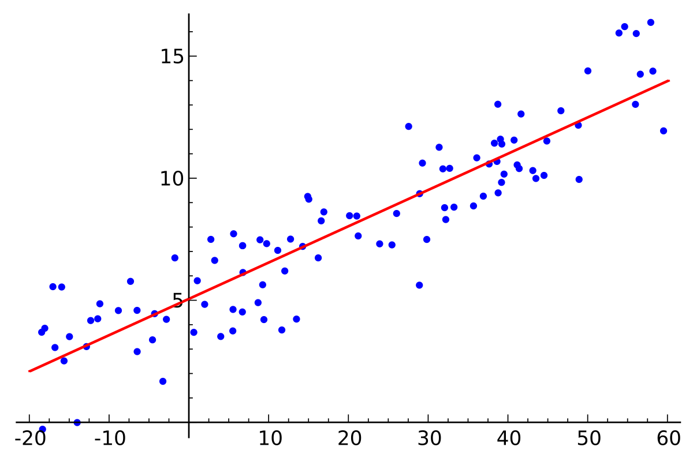
Before getting and knowing about machine learning, we have know all the models…..
What is linear regression??
Before knowing what is linear regression, let us get ourselves accustomed to regression. Regression is a method of modelling a target value based on independent predictors. This method is mostly used for forecasting and finding out cause and effect relationship between variables. Regression techniques mostly differ based on the number of independent variables and the type of relationship between the independent and dependent variables.
For better understanding in the below , we can see the graph;

Slide 3
In the above graph we can see the Simple linear regression is a type of regression analysis where the number of independent variables is one and there is a linear relationship between the independent(x) and dependent(y) variable. The red line in the above graph is referred to as the best fit straight line. Based on the given data points, we try to plot a line that models the points the best.
Assumptions for linear regression:
As we know that linear regression is a useful statistical method we can use to understand the relationship between two variables, x and y. However, before we conduct linear regression, we must first make sure that three assumptions are met:
1.Linear relationship:
The easiest way to detect if this assumption is met is to create a scatter plot of x vs. y. This allows you to visually see if there is a linear relationship between the two variables. If it looks like the points in the plot could fall along a straight line, then there exists some type of linear relationship between the two variables and this assumption is met.
2.Homoscedasticity:
The next assumption of linear regression is that the residuals have constant variance at every level of x. This is known as homoscedasticity. When this is not the case, the residuals are said to be heteroscedasticity , this heteroscedasticity has variance at level of ‘x’.
3: Normality:
The next assumption of linear regression is that the residuals are normally distributed. We can also say normality as gaussian distribution.
A Q-Q plot, short for quantile-quantile plot, is a type of plot that we can use to determine whether or not the residuals of a model follow a normal distribution. If the points on the plot roughly form a straight diagonal line, then the normality assumption is met.

Slide 4
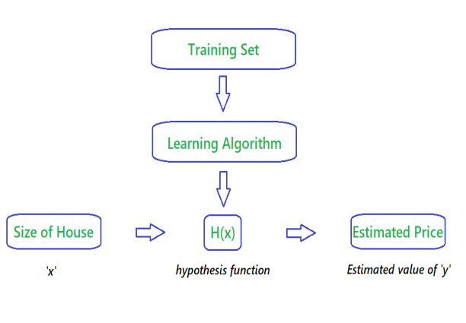
# Mathematical Intuition behind the Linear Regression:
A Mathematical intuition and quick guide and understanding of how Linear Regression Algorithms works.
A linear equation that models a function such that if we give any x to it, it will predict a value y , where both x and y are input and output variables respectively. These are numerical and continuous values.
It is the most simple and well known algorithm used in machine learning.
The below flowchart represents that we choose our training set, feed it to an algorithm, it will learn the patterns and will give a output function called “Hypothesis function”. we then give any x value to that function and it will output an estimated y values for it.

Slide 5




# Evaluation Metrics and when to use of metrics:
Evaluation metrics are a measure of how good a model performs and how well it approximates the relationship. Let us look at MSE, MAE, R-squared, Adjusted R-squared, and RMSE.
1.Mean Absolute Error (MAE):
It is measured by taking the average of the absolute difference between actual values and the predictions. Here “y “ is the actual value and “y^” is predicted value. we have make sure that the model should get less error, the error might depends upon the data that we taken. we cannot say that MAE is the best model , we can go for another model….
2.Root Mean Squared Error (RMSE):
It is a modification of MAE and this is the square root of the average of the squared difference of the predicted and actual values.
3.R-squared:
Here we can say strongly that the model is perfect by using R-squared. It measures the strength of the relationship between your model and the dependent variable.
4.Mean squared error(MSE):
MSE penalizes large errors.

Slide 6
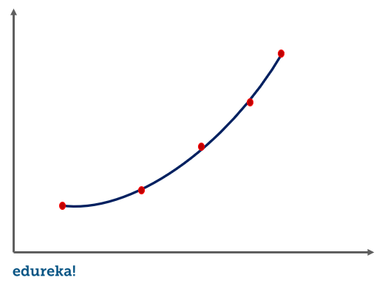
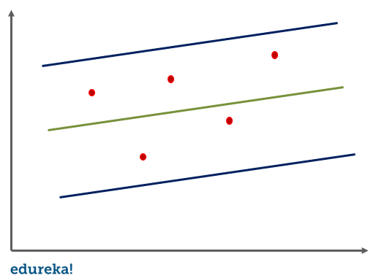
# Types of linear regression:
1.Simple linear regression:
Regression techniques mostly differ based on the number of independent variables and the type of relationship between the independent and dependent variables.
2.polynomial regression:
in this regression technique, we transform the original features into polynomial features of a given degree and the perform regression on it.
3.Support vector regression:
SVR ,we identified the hyperplane with maximum margin such that maximum number of data points are with those margins.

Slide 7
# Advantages and Disadvantages of linear regression:
Advantages:
1. Linear Regression performs well when the dataset is linearly separable. We can use it to find the nature of the relationship among the variables.
2. Linear Regression is easier to implement, interpret and very efficient to train.
3. Linear Regression is prone to over-fitting but it can be easily avoided using some dimensionality reduction techniques, regularization (L1 and L2) techniques and cross-validation.
Disadvantages:
1. Main limitation of Linear Regression is the assumption of linearity between the dependent variable and the independent variables. In the real world, the data is rarely linearly separable. It assumes that there is a straight-line relationship between the dependent and independent variables which is incorrect many times.
2. Prone to outliers: Linear regression is very sensitive to outliers (anomalies). So, outliers should be analyzed and removed before applying Linear Regression to the dataset.
3. Prone to noise and overfitting: If the number of observations are lesser than the number of features, Linear Regression should not be used, otherwise it may lead to overfit because is starts considering noise in this scenario while building the model.
.

Slide 8
# Gradient descent:
An algorithm to minimize the function and by optimizing its parameters. A gradient descent start with a random guess and slowly predict the correct answer. In gradient descent the predictions will go downwards and upwards and this how the parameters are optimized.
# Types of Gradient descent:
1.Batch Gradient descent:
Batch gradient descent, also called vanilla gradient descent, calculates the error for each example within the training dataset, but only after all training examples have been evaluated does the model get updated. This whole process is like a cycle and it's called a training epoch.
2.Stochastic Gradient descent:
By contrast, stochastic gradient descent (SGD) does this for each training example within the dataset, meaning it updates the parameters for each training example one by one. Depending on the problem, this can make SGD faster than batch gradient descent. One advantage is the frequent updates allow us to have a pretty detailed rate of improvement.
3.Mini-Batch Gradient descent:
Mini-batch gradient descent is the go-to method since it’s a combination of the concepts of SGD and batch gradient descent. It simply splits the training dataset into small batches and performs an update for each of those batches. This creates a balance between the robustness of stochastic gradient descent and the efficiency of batch gradient descent.
.

Slide 9
# Lasso regression:
Lasso regression is also used to reduce the overfitting and addition to it. It also helps in feature selection when the any feature slope value is nearer to zero it will remove that feature considering it as unimportant feature.
# Ridge regression:
It is used to reduce the overfitting and helps to get the less variance, less bias in ridge regression the slope values will shrink and never reaches to zero.
.

